Slide 1


PRODUCT KNOWLEDGE
HOTSPOT

Slide 2
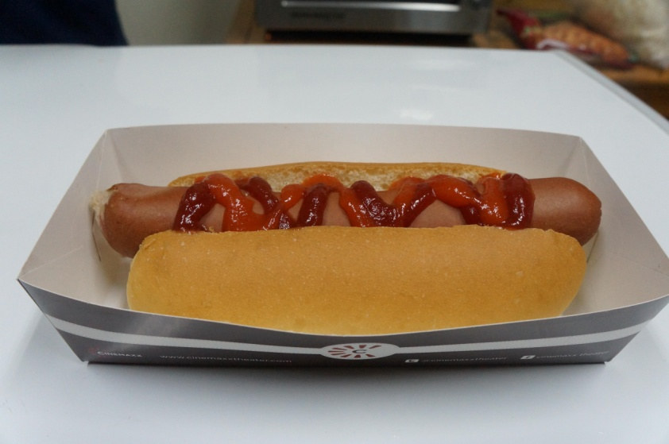
SMOKED BEEF HOTDOG
Product knowledge
Hotspot
Bun : 1 pcs
Beef Sausage : 1 pcs
Chilli sauce : 30 gr
Tomato sauce : 30 gr
Packaging : Hotdog tray + Cover
Tissue : 1 Pcs

Slide 3
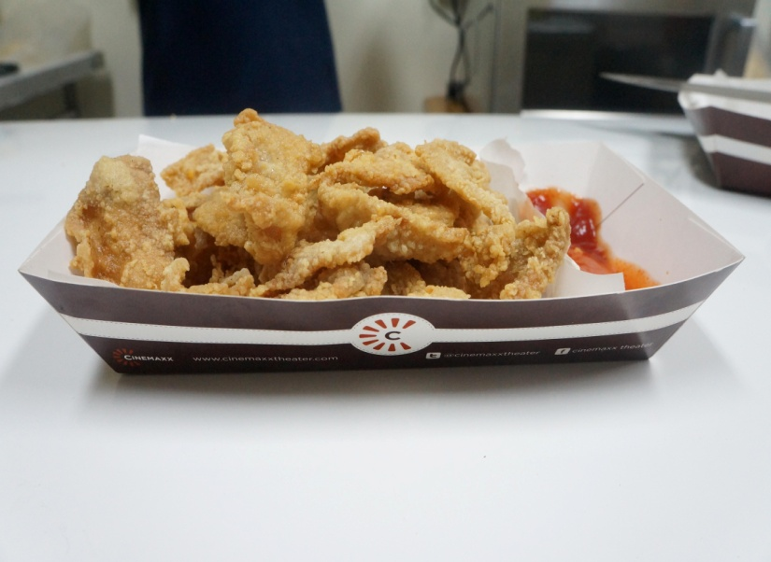
CHICKEN CRISPY
Product knowledge
Hotspot
Chicken Skin : 150 gr
Shortening : 50 ml
Chilli sauce : 30 gr
Tomato sauce : 30 gr
Packaging : Food tray + Lid
Tissue : 1 pcs

Slide 4
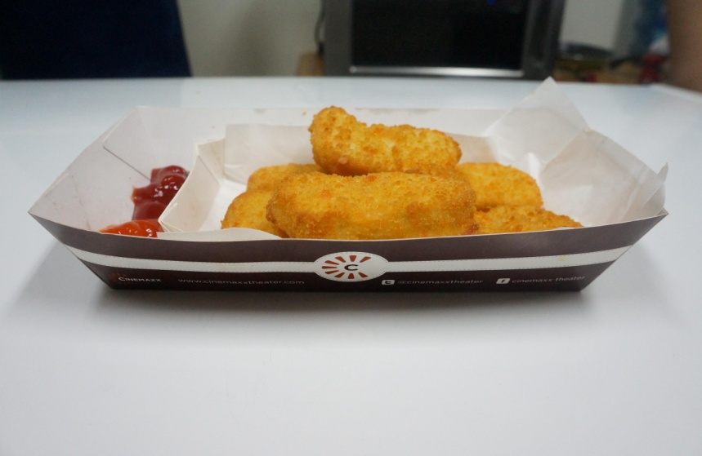
CHICKEN NUGGET
Product knowledge
Hotspot
Chicken Nugget : 5 pcs
Shortening : 50 ml
Chilli sauce : 30 gr
Tomato sauce : 30 gr
Packaging : Food tray + Lid
Tissue : 1 pcs

Slide 5
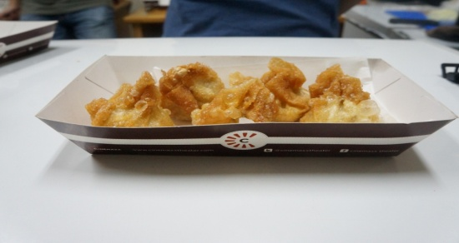
CHICKEN WONTON
Chicken Wonton : 5 pcs
Shortening : 50 ml
Chilli sauce : 30 gr
Tomato sauce : 30 gr
Packaging : Food tray + Lid
Tissue : 1 pcs
Product knowledge
Hotspot

Slide 6
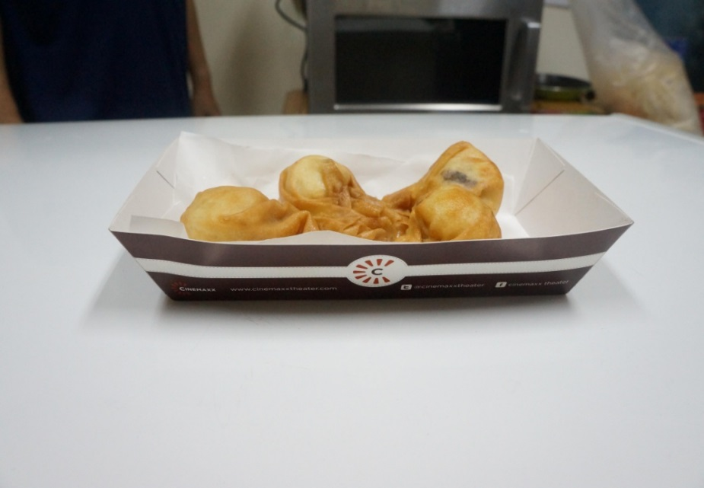
TAPE COKLAT
Tape Coklat : 4 pcs
Shortening : 50 ml
Packaging : Food tray + Lid
Tissue : 1 pcs
Served with icing sugar
Product knowledge
Hotspot

Slide 7
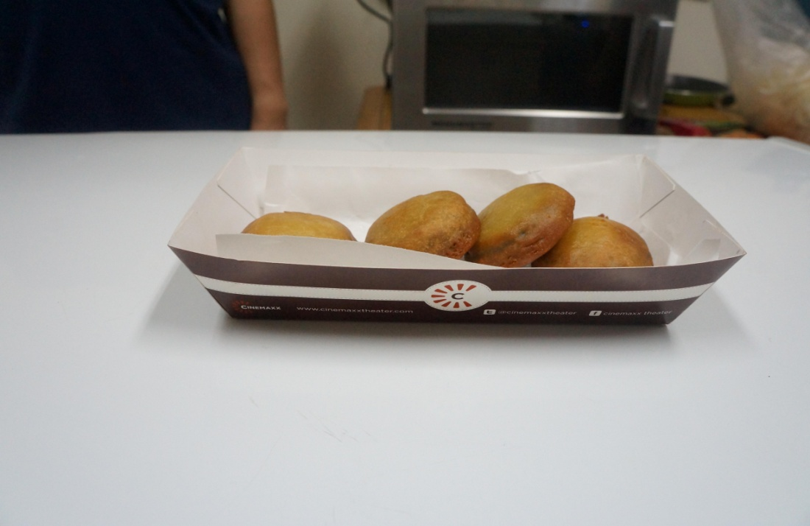
FRIED OREO
Fried Oreo : 4 pcs
Shortening : 50 ml
Packaging : Food tray + Lid
Tissue : 1 pcs
Serve with icing sugar
Product knowledge
Hotspot

Slide 8
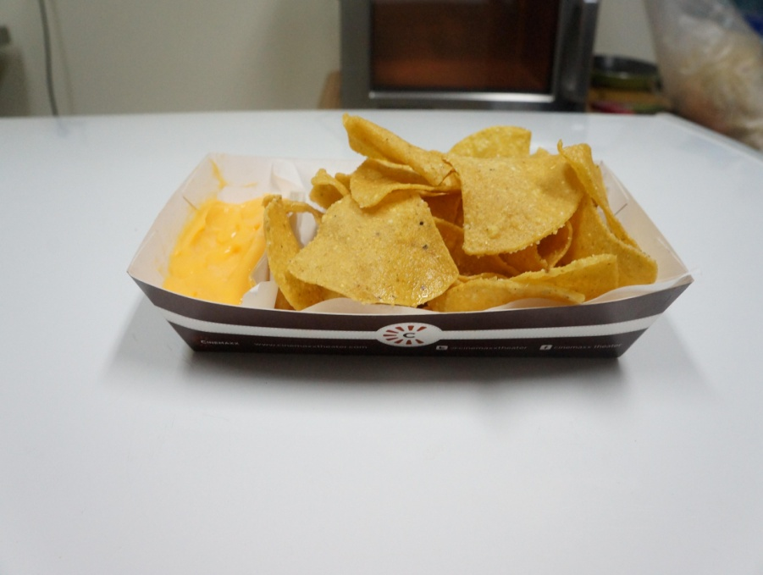
NACHOS WITH CHEESE
Tortilla : 70 gr
Cheese sauce : 30 gr
Shortening : 50 gr
Packaging : Food tray + Lid
Tissue : 1 pcs
1 ctn = 5 kg
Product knowledge
Hotspot

Slide 9
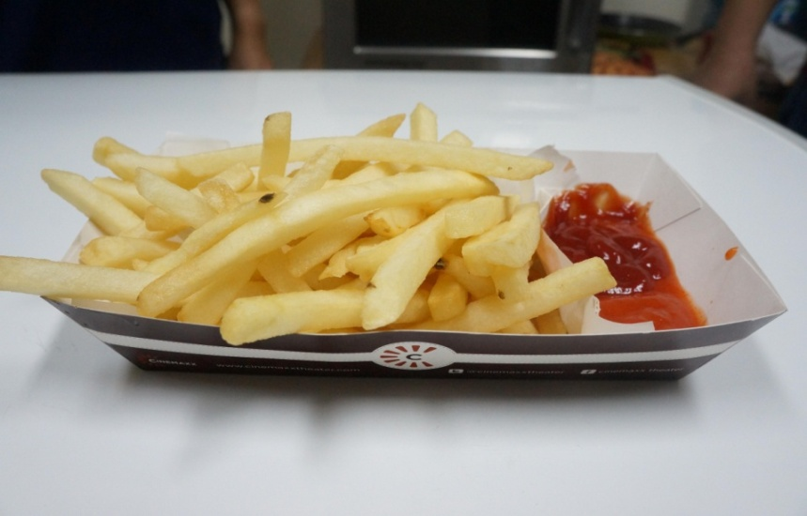
FRENCH FRIES
French Fries : 200 gr
Chili sauce : 30 gr
Tomato sauce : 30 gr
Shortening : 50 gr
Packaging : Food tray + Lid
Tissue : 1 pcs
1 ctn = 6 bag , per bag 2,4 kg
Product knowledge
Hotspot

Slide 10
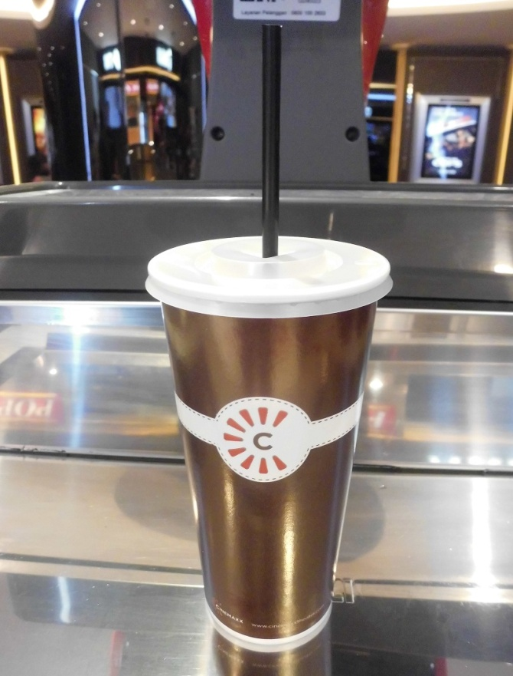
B.I.B (Softdrink)
1 box coke : 12500 gr
1 box fanta : 12500 gr
1 box sprite : 12500 gr
1 box Lemon Tea : 12500 gr
1 tank co : 8000 gr
Product knowledge
Hotspot

Slide 11
Serve B.I.B (Softdrink)
COCA COLA | 12 Oz | 16 Oz | 22 Oz | 32 Oz
Syrup | 57,1 | 76,22 | 104,8 | 151,2
Co |  | 9,8 | 13,4 | 19,5
Paper Cup | 1 | 1 | 1 | 1

Slide 12
Serve B.I.B (Softdrink)
COCA COLA - FANTA | 12 Oz | 16 Oz | 22 Oz | 32 Oz
Syrup | 74 | 98,4 | 135,4 | 195,3
Co | 9,4 | 12,6 | 17,3 | 25
Paper Cup | 1 | 1 | 1 | 1

Slide 13
Serve B.I.B (Softdrink)
SPRITE – LEMON TEA (w/o CO) | 12 Oz | 16 Oz | 22 Oz | 32 Oz
Syrup | 68 | 91 | 125 | 180
Co (Sprite) | 8,7 | 11,6 | 16 | 23,1
Paper Cup | 1 | 1 | 1 | 1

Slide 14
TOTAL SERVE B.I.B (Softdrink)
(Cup 22 Oz)
Product knowledge
Hotspot
Cocacola (12500 gr) : 120 Cup
Co : 598 Cup

Slide 15
COLD MILO (Cup 16 Oz)
1 Pack : 960 gram
Water : 7 lt (7000 ml)
Papper Cup : 16 Oz (331 ml)
Total Serve/Pack : 21,15 Cup/ 21 Cup
1 cup 16 oz : 45,39 gram
Life time 18 Jam
1 Ctn = 16 pack
Product knowledge
Hotspot

Slide 16
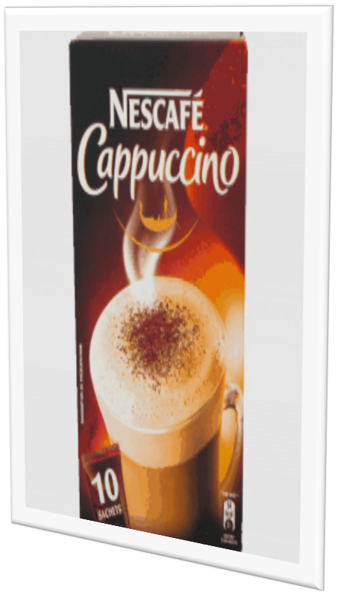
ICE CAPPUCCINO
1 Pack : 500 gram
Water : 3 lt (3000 ml)
Papper Cup : 16 Oz (331 ml)
Total Serve/Pack : 9,06 Cup → 9 Cup
1 Cup 16oz : 55,19 gram
1 Ctn = 30 pack
Product knowledge
Hotspot

Slide 17

ICE CAPUCHINO
SELESAI
Product knowledge
Hotspot

